Slide 1
Multi-scale graph matching
Pattern recognition project
Student: Thomas Noguer
Supervisor: Romain Raveaux
M2RI CADS, 2014

Slide 2
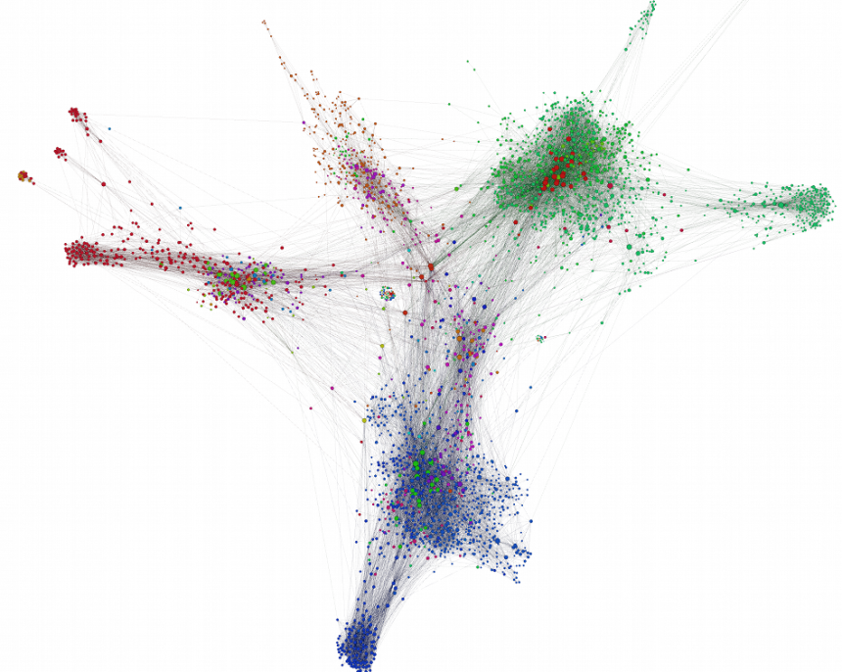
Introduction
Graph matching on high sized graph
Community detection to reduce the size of a graph
Graph Edit distance
Louvain’s method

Slide 3

Contents
Graph Edit Distance
Community detection: Louvain
Multi-scale Graph Edit Distance
Results
Perspectives

Slide 4
Graph Edit Distance
- Graph Edit Distance
- Community Detection
- Multi-Scale Graph Edit Distance
- Results
- Perspectives
Find the best edit path between two graphs G1, G2
The sequence of addition/substitution/deletion of nodes and edges of G1 to form G2
Minimize the total cost
Cost of substitution = 0
Cost of addition/deletion = 1

Slide 5
Graph Edit Distance
- Graph Edit Distance
- Community Detection
- Multi-Scale Graph Edit Distance
- Results
- Perspectives
G1
G2

Slide 6
Graph Edit Distance
- Graph Edit Distance
- Community Detection
- Multi-Scale Graph Edit Distance
- Results
- Perspectives
G1
G2
Cost = 2

Slide 7
Graph Edit Distance
- Graph Edit Distance
- Community Detection
- Multi-Scale Graph Edit Distance
- Results
- Perspectives
G1
G2
Cost = 3

Slide 8
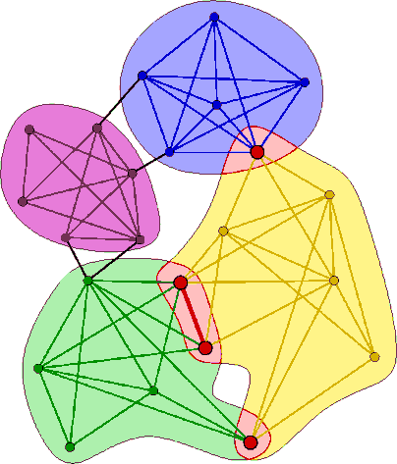
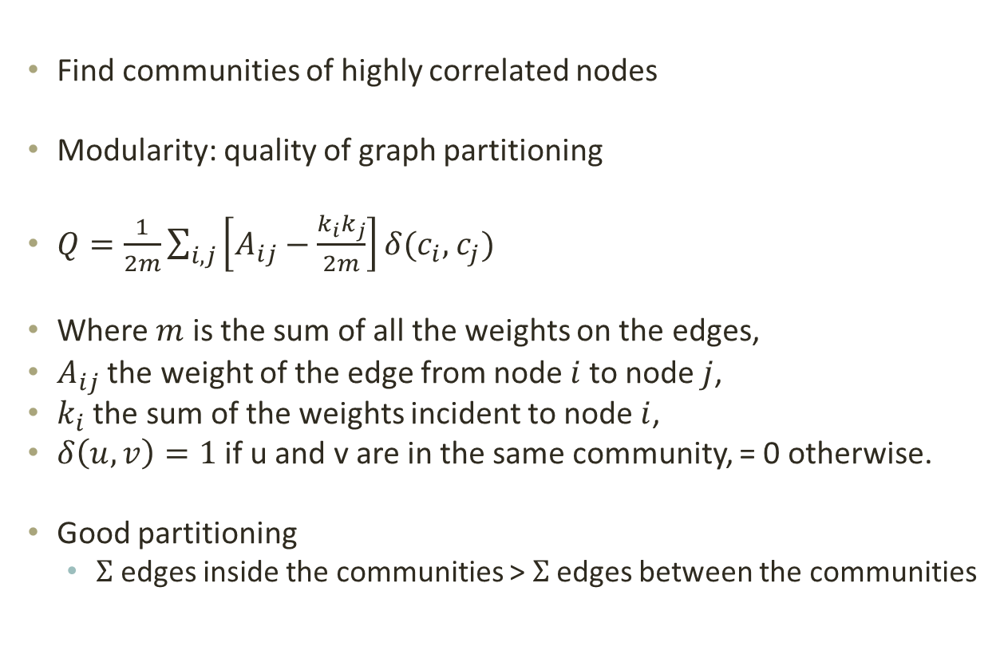
Community Detection: Louvain
- Graph Edit Distance
- Community Detection
- Multi-Scale Graph Edit Distance
- Results
- Perspectives
Find communities of highly correlated nodes
Modularity: quality of graph partitioning
$Q=\frac{1}{2m}\sum_{i,j}{\left[A_{ij}−\frac{k_{i}k_{j}}{2m}\right]δ(c_{i},}$ $c_{j})$
Where $m$ is the sum of all the weights on the edges,
$A_{ij}$ the weight of the edge from node $i$to node $j$,
$k_{i}$ the sum of the weights incident to node $i$,
$δ\left(u,v\right)=1$ if u and v are in the same community, = 0 otherwise.
Good partitioning
$Σ$ edges inside the communities > $Σ$ edges between the communities

Slide 9
Community Detection: Louvain
- Graph Edit Distance
- Community Detection
- Multi-Scale Graph Edit Distance
- Results
- Perspectives

Slide 10
Community Detection: Louvain
- Graph Edit Distance
- Community Detection
- Multi-Scale Graph Edit Distance
- Results
- Perspectives

Slide 11
Community Detection: Louvain
- Graph Edit Distance
- Community Detection
- Multi-Scale Graph Edit Distance
- Results
- Perspectives
9
3
3
Q = 0.29
1
3

Slide 12
Community Detection: Louvain
- Graph Edit Distance
- Community Detection
- Multi-Scale Graph Edit Distance
- Results
- Perspectives
9
9
Q = 0.447
1

Slide 13
Multi-Scale Graph Edit Distance
- Graph Edit Distance
- Community Detection
- Multi-Scale Graph Edit Distance
- Results
- Perspectives
How do we combine the two methods?
Solution without an arbitrary value/parameter
Recursive approach
Cost of a community = GED

Slide 14
Multi-Scale Graph Edit Distance
- Graph Edit Distance
- Community Detection
- Multi-Scale Graph Edit Distance
- Results
- Perspectives

Slide 15
Multi-Scale Graph Edit Distance
- Graph Edit Distance
- Community Detection
- Multi-Scale Graph Edit Distance
- Results
- Perspectives

Slide 16
Multi-Scale Graph Edit Distance
- Graph Edit Distance
- Community Detection
- Multi-Scale Graph Edit Distance
- Results
- Perspectives

Slide 17
Multi-Scale Graph Edit Distance
- Graph Edit Distance
- Community Detection
- Multi-Scale Graph Edit Distance
- Results
- Perspectives

Slide 18
Multi-Scale Graph Edit Distance
- Graph Edit Distance
- Community Detection
- Multi-Scale Graph Edit Distance
- Results
- Perspectives
Cost = 9

Slide 19
Multi-Scale Graph Edit Distance
- Graph Edit Distance
- Community Detection
- Multi-Scale Graph Edit Distance
- Results
- Perspectives
Cost of substitution of
with
= 9

Slide 20
Multi-Scale Graph Edit Distance
- Graph Edit Distance
- Community Detection
- Multi-Scale Graph Edit Distance
- Results
- Perspectives
Compare subsets of the graphs
Divide the calculation of the edit distance
Faster but not exact

Slide 21
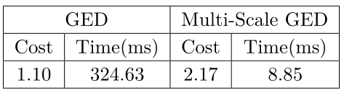
Results
- Graph Edit Distance
- Community Detection
- Multi-Scale Graph Edit Distance
- Results
- Perspectives
GED vs Multi-Scale GED

Slide 22
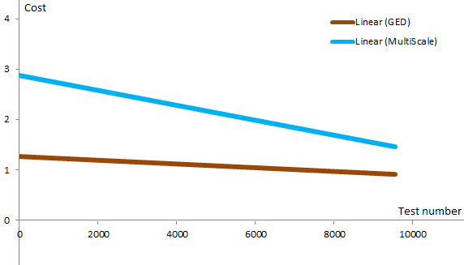
Results
- Graph Edit Distance
- Community Detection
- Multi-Scale Graph Edit Distance
- Results
- Perspectives
GED vs Multi-Scale GED

Slide 23
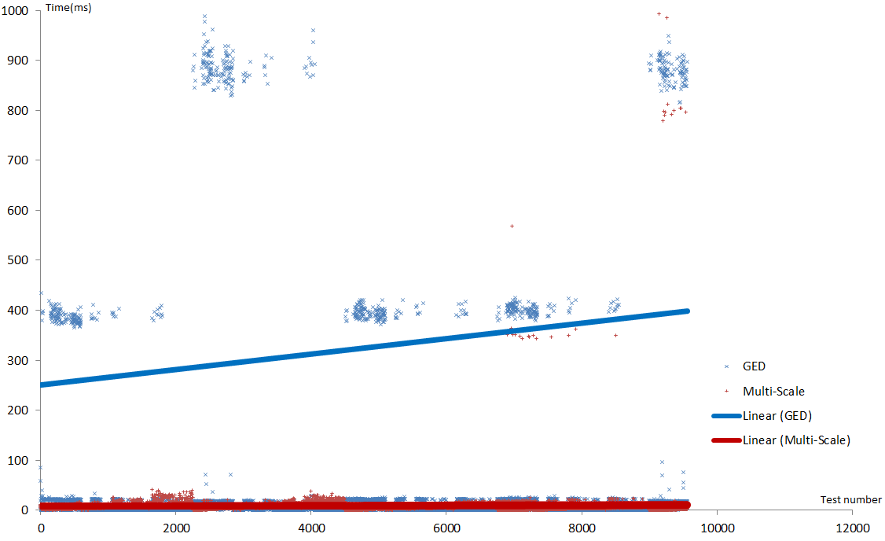
Results
- Graph Edit Distance
- Community Detection
- Multi-Scale Graph Edit Distance
- Results
- Perspectives
GED vs Multi-Scale GED

Slide 24
Perspectives
- Graph Edit Distance
- Community Detection
- Multi-Scale Graph Edit Distance
- Results
- Perspectives
Good results
Tests on high sized graphs
Use as an upper bound in a branch & bound algorithm

Slide 25
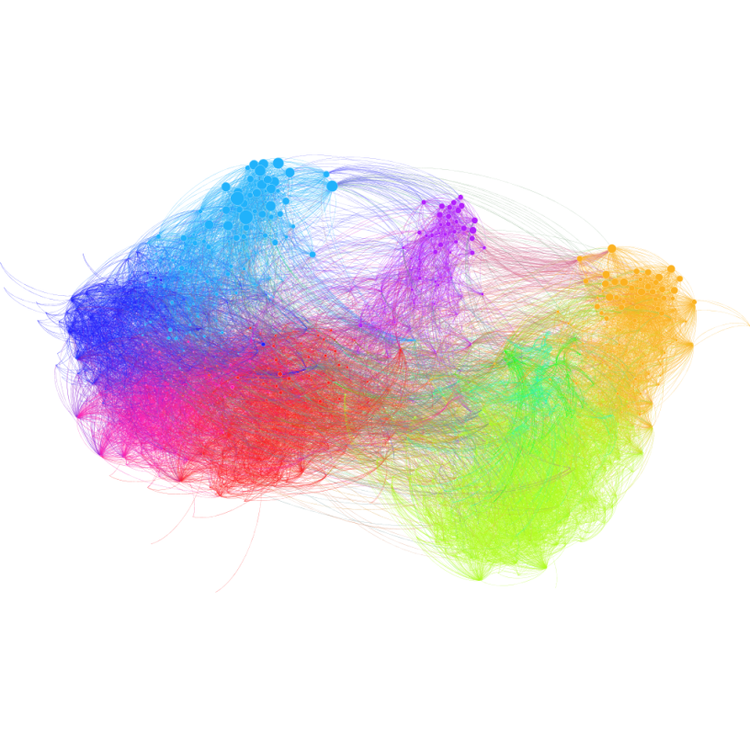
Conclusion
Fulfilling project
Some difficulties in the implementation
Publication ahead

